Slide 1

构建高性能IP负载均衡技术
李建国
byjgli@gmail.com
搜狐研究院 基础架构部

Slide 2


硬件体系架构
linux内核虚拟服务器
DPDK：intel数据平面解决方案
Missouri：IP负载均衡解决方案

Slide 3

硬件体系架构
PCI Express Interface
Xeon E5-2600 Product Family
82599ES Ethernet Controller

Slide 4
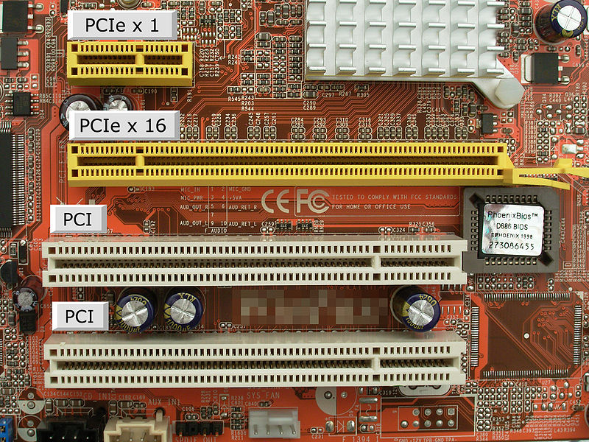
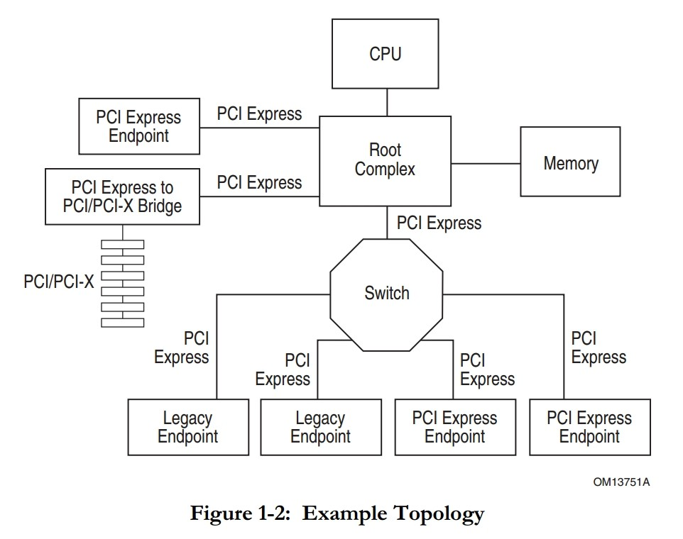
PCI Express Interface

Slide 5
PCI Express Interface
版本 | 原始传输率 | 单向单通道带宽 | 双向x1 通道带宽 | 双向x2 通道带宽 | 双向x4 通道带宽 | 双向x8 通道带宽 | 双向x16 通道带宽
PCIE 1.0 | 2.5GT/s | 250MB/s | 500MB/s | 1GB/s | 2GB/s | 4GB/s | 8GB/s
PCIE 2.0 | 5.0GT/s | 500MB/s | 1GB/s | 2GB/s | 4GB/s | 8GB/s | 16GB/s
PCIE 3.0 | 8.0GT/s | 1GB/s | 2GB/s | 4GB/s | 8GB/s | 16GB/s | 32GB/s
PCIE 4.0 | 16.0GT/s | 2GB/s | 4GB/s | 8GB/s | 16GB/s | 32GB/s | 64GB/s

Slide 6
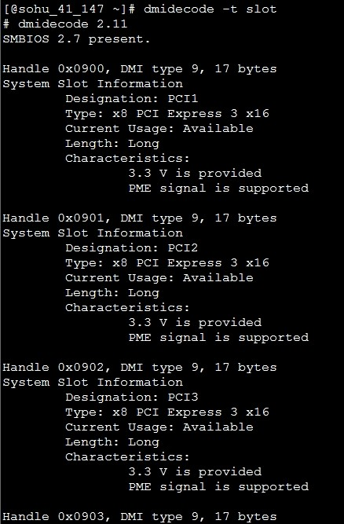
PCI Express Interface
# dmidecode –t slot

Slide 7
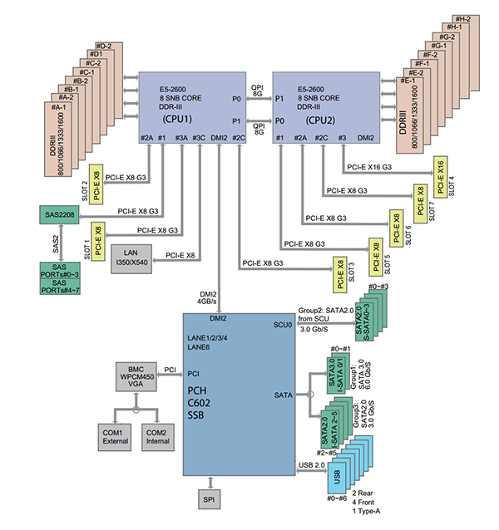
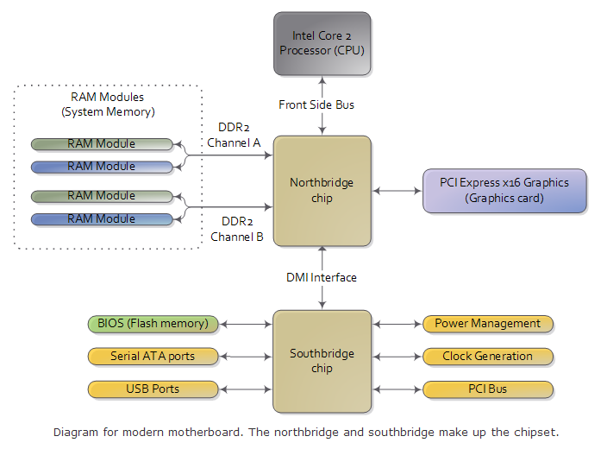
x86体系架构变迁

Slide 8
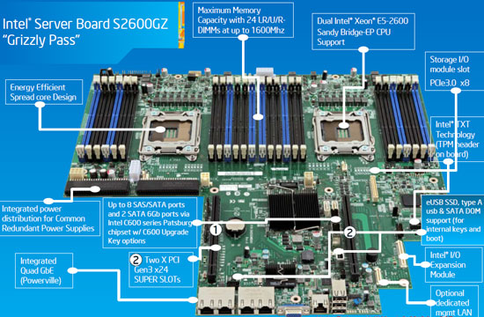
Xeon E5-2600 Product Family

Slide 9
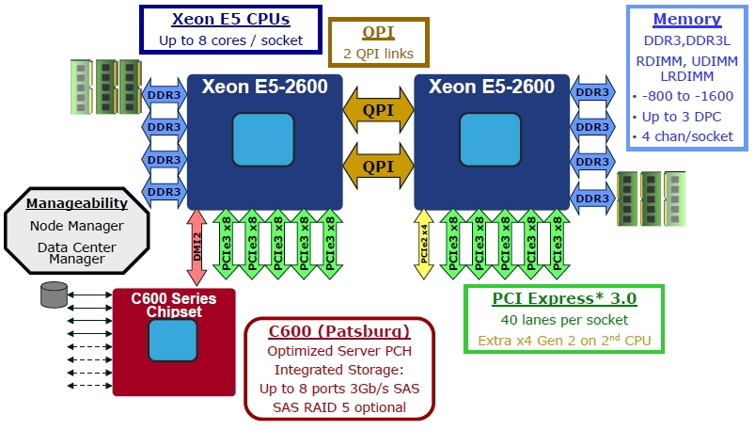
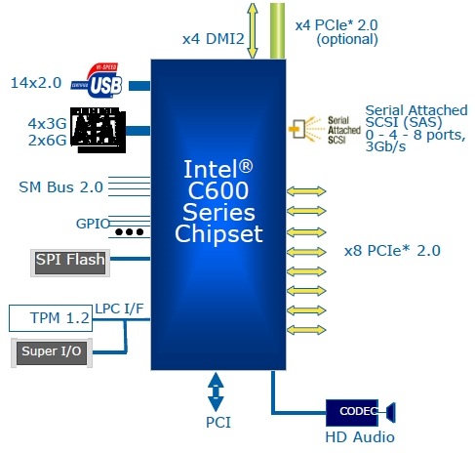
Xeon E5-2600 Product Family
1 lik: 28.8GB/s
2 lik: 57.6GB/s
Intel Xeon Processor E5-2620
QPI Speed 7.2 GT/s
3.6 GHz
× 2 bits/Hz （双倍数据传送速率）
× 20 （QPI连接宽度）
× (64/80) （数据比特数/数据数据包比特数）
× 2 （各向发送和接收作业同步进行）
÷ 8 （每字节比特数）
= 28.8 GB/s
• The Physical layer consists of the actual wires carrying the signals, as well as
circuitry and logic to support ancillary features required in the transmission and
receipt of the 1s and 0s. The unit of transfer at the Physical layer is 20-bits, which
is called a Phit (for Physical unit).
• The Link layer is responsible for reliable transmission and flow control. The Link
layer’s unit of transfer is 80-bits, which is called a Flit (for Flow control unit).
• The Routing layer provides the framework for directing packets through the
fabric.
• The Transport layer is an architecturally defined layer (not implemented in the
initial products) providing advanced routing capability for reliable end-to-end
transmission.
• The Protocol layer is the high-level set of rules for exchanging packets of data
between devices. A packet is comprised of an integral number of Flits
Intel Xeon Processor E5-2620
DDR3-800/1066/1333
DDR3-800 Bandwidth = 4*0.8Gb/s*64b÷8 = 25.6GB/s
DDR3-1066 Bandwidth = 4*1.066Gb/s*64b÷8 = 34.1GB/s
DDR3-1333 Bandwidth = 4*1.333Gb/s*64b÷8 = 42.6GB/s
1 chan:10.6GB/s
4 chan:42.6GB/s
4GB/s
Direct Media Interface 2 (DMI2) connects the processor to the Platform Controller Hub (PCH). DMI2 is similar to a four-lane PCI Express* supporting a speed of 5 GT/s per lane.
PCIE e3
x8: 16GB/s

Slide 10
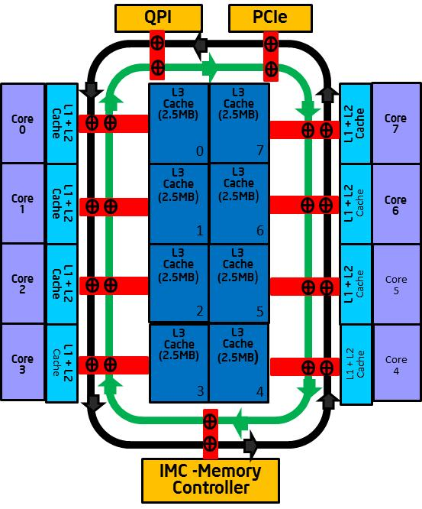
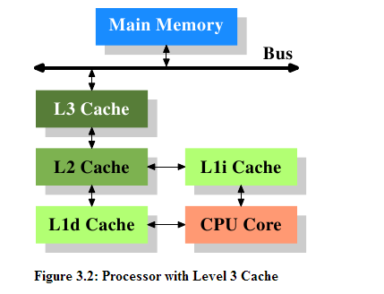
Xeon E5-2600 Product Family
google： What every programmer should know about memory

Slide 11
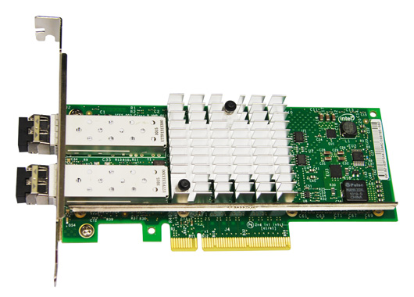
82599ES Ethernet Controller

Slide 12
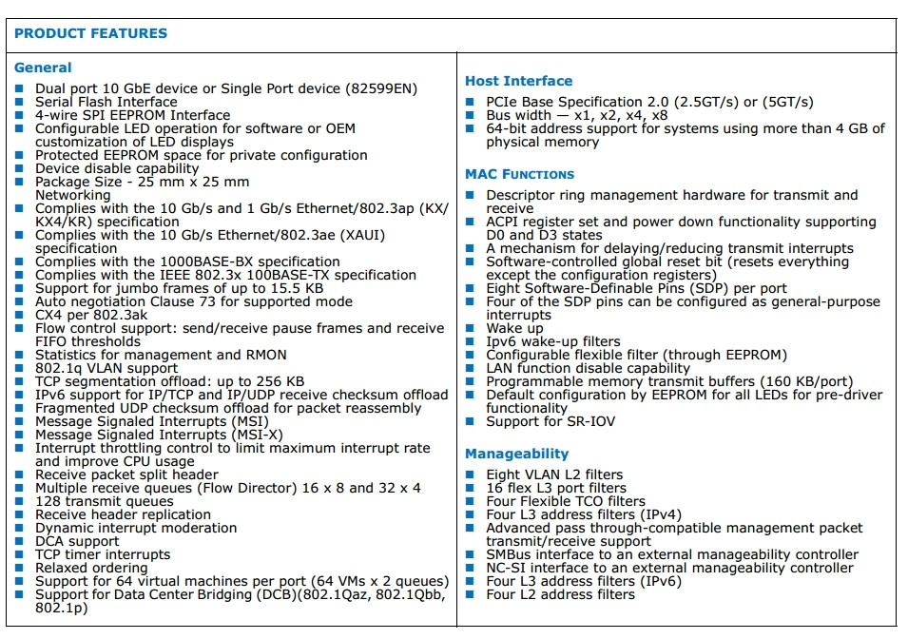
82599ES Ethernet Controller

Slide 13
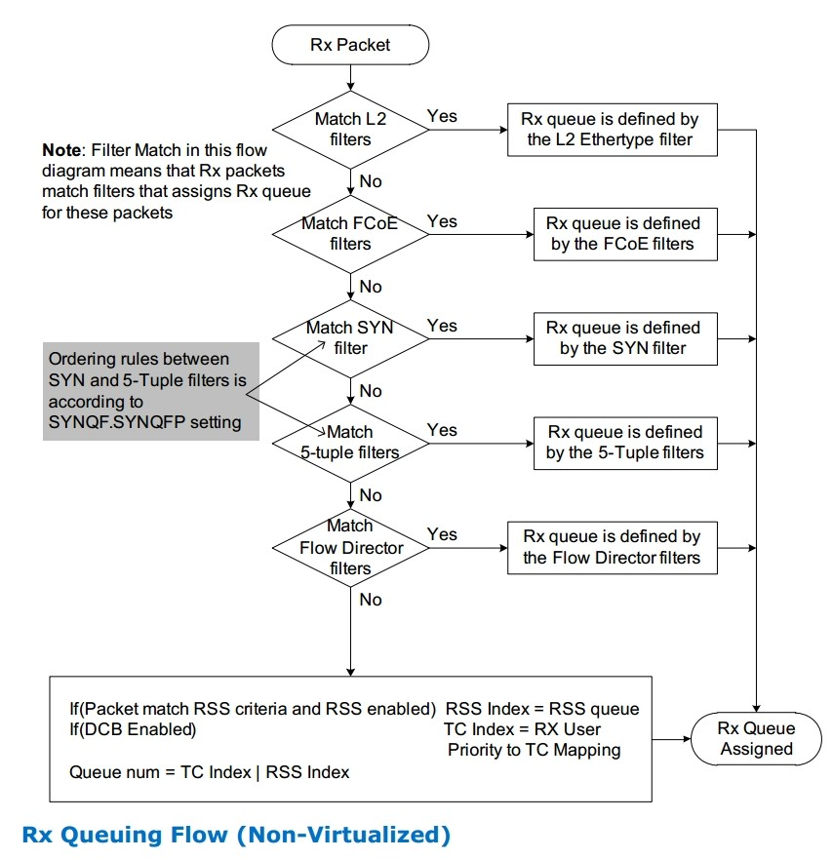
82599ES Ethernet Controller

Slide 14
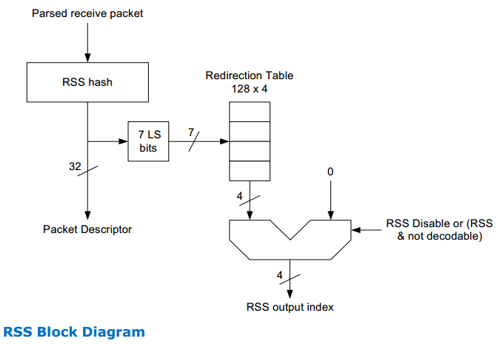
82599ES Ethernet Controller

Slide 15
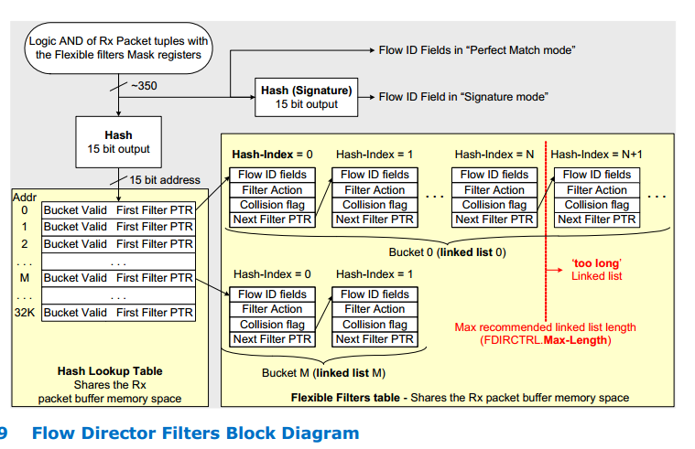
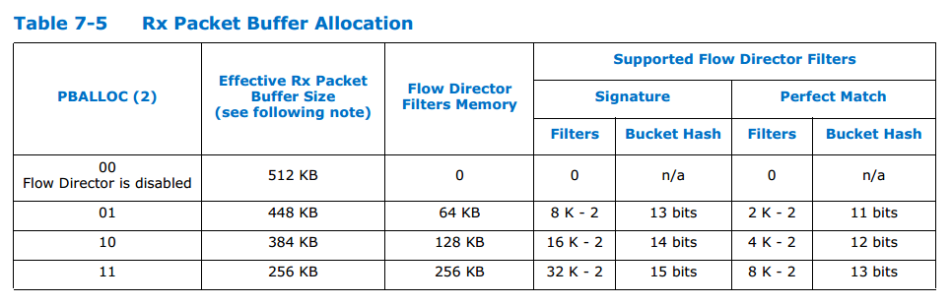
82599ES Ethernet Controller

Slide 16
linux内核虚拟服务器
linux kernel network data flow
LVS ：Linux Virtual Server
kernel tunning

Slide 17
Linux Networking Layers
Network Applications
User
Kernel
BSD Sockets
Socket Interface
INET Sockets
TCP
UDP
Protocol Layers
IP
ARP
Network Devices
PPP
SLIP
Ethernet

Slide 18
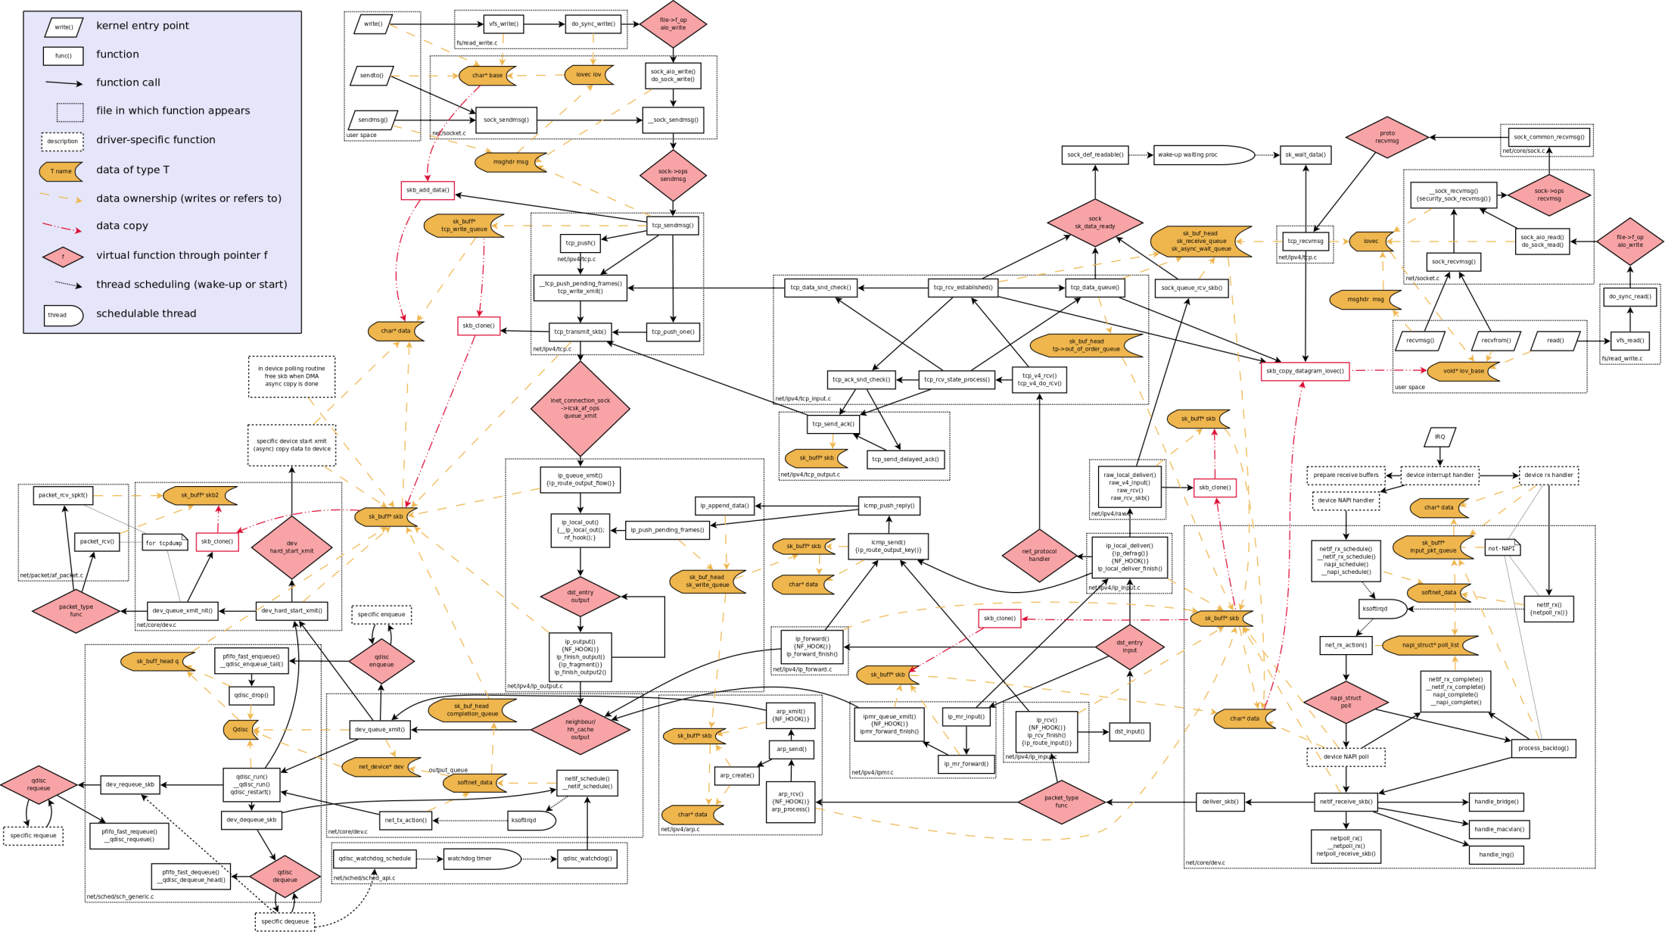
linux kernel network data flow

Slide 19
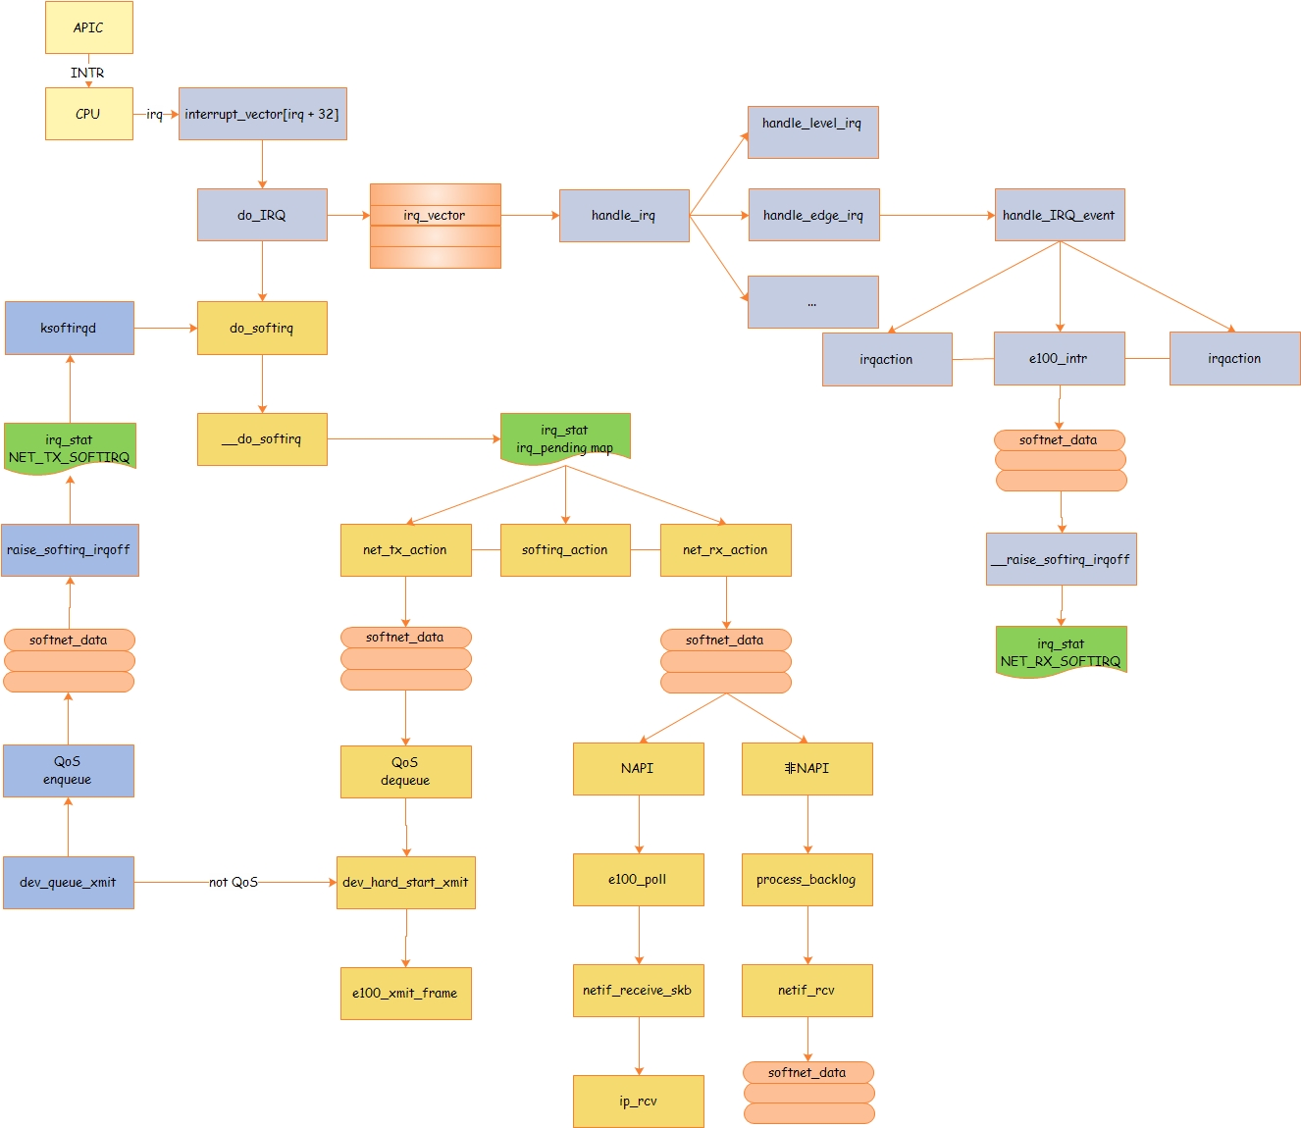
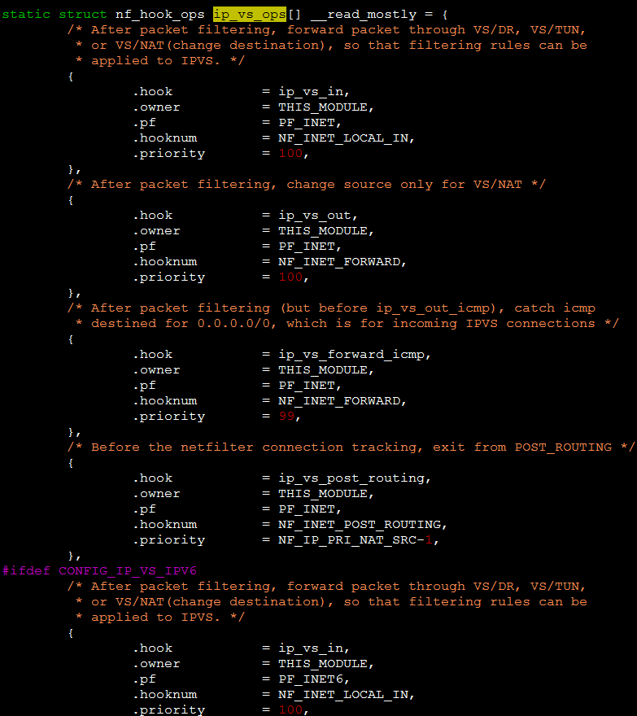
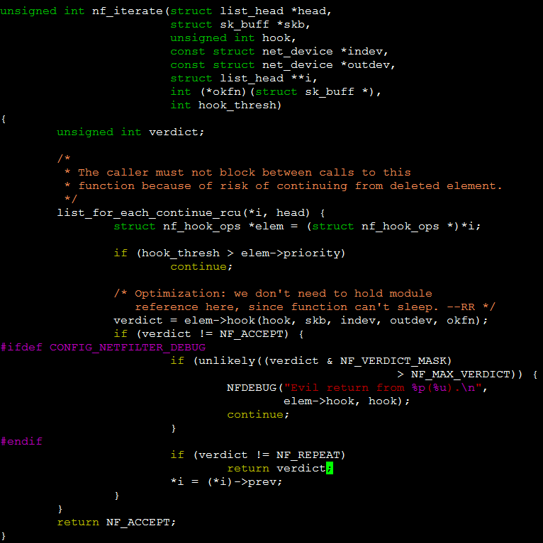
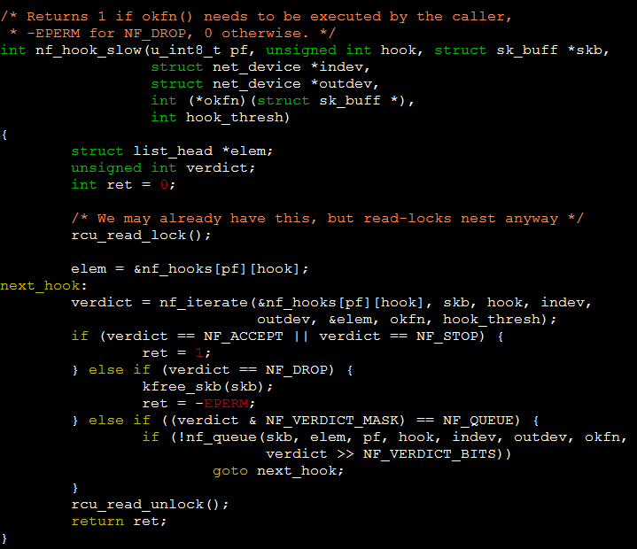
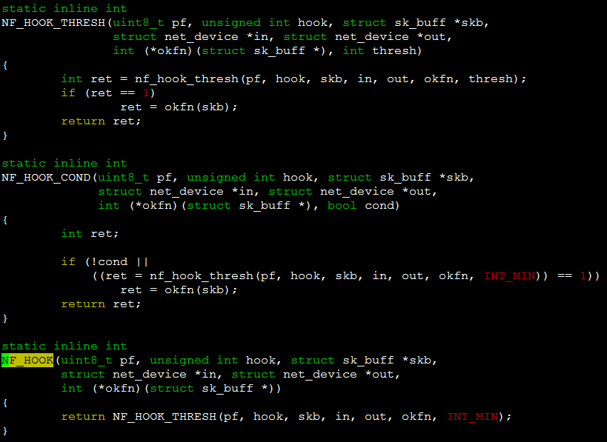
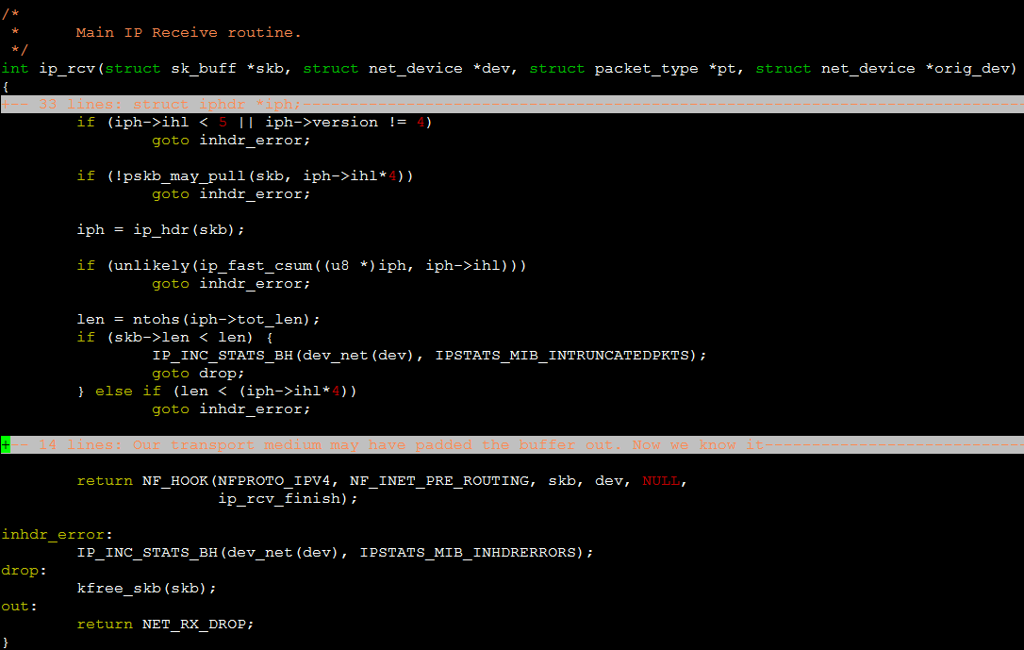
linux kernel network data flow
linux kernel network data flow

Slide 20
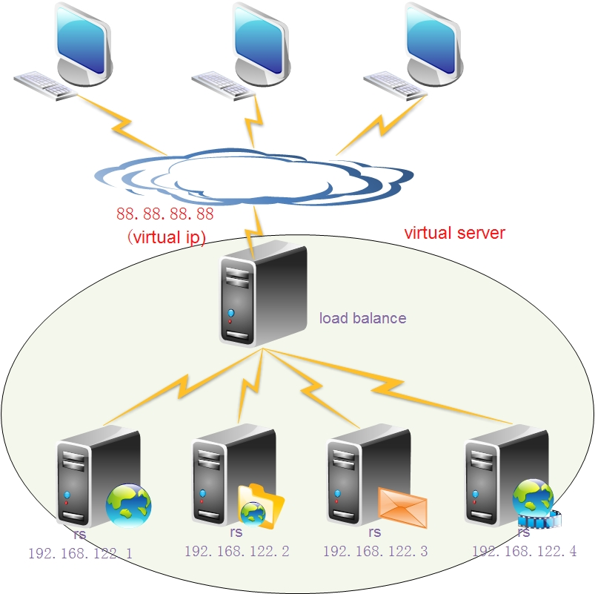
LVS ：Linux Virtual Server

Slide 21
LVS ：Linux Virtual Server
工作模式：NAT/FULLNAT/DR/TUNNEL
传输协议：TCP/UDP
调度算法：RR/WRR/LCS/WLCS/...

Slide 22
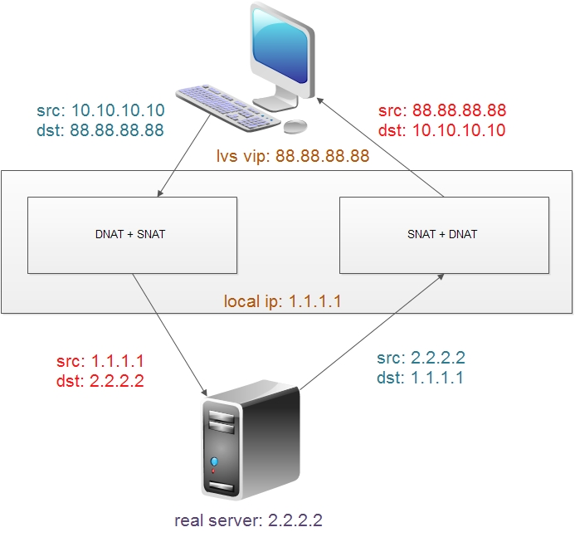
LVS ：FULLNAT

Slide 23
LVS ：FULLNAT
real servere间可以跨vlan通讯，in/out流都经过lvs，降低运维成本
集群方式部署，扩展容易
synflood及其他TCP FLAGS DDOS攻击防御，抗攻击能力强

Slide 24
kernel tunning
多队列网卡，中断绑定
软中断均衡，RPS/RFS
lvs代码：session hash table，session hash bucket lock 等
其他……

Slide 25
DPDK：intel数据平面解决方案
who
why
what

Slide 26
国内的应用
百度：数据中心
阿里：协议栈，linux虚拟服务器
腾讯：流量清洗
其他：……

Slide 27
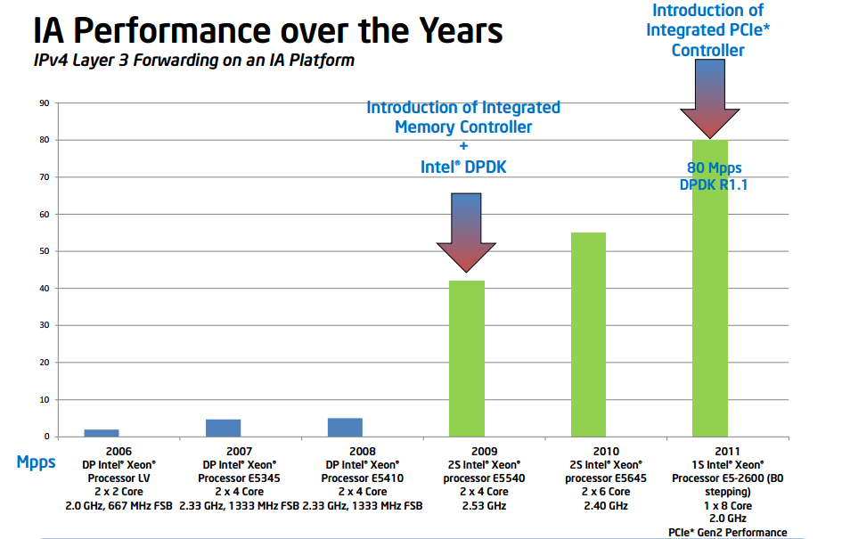
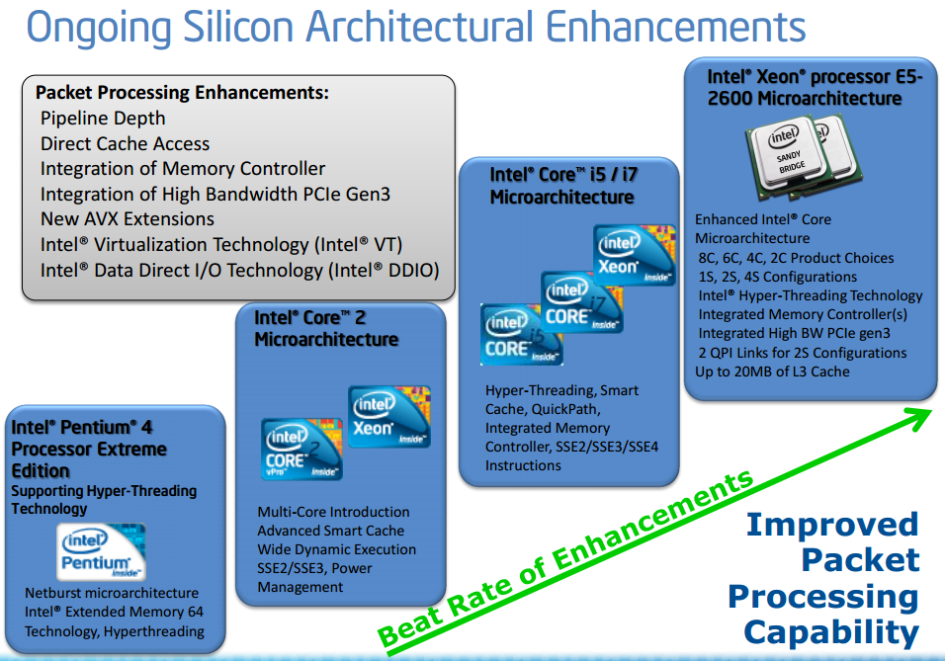
DPDK产生背景

Slide 28
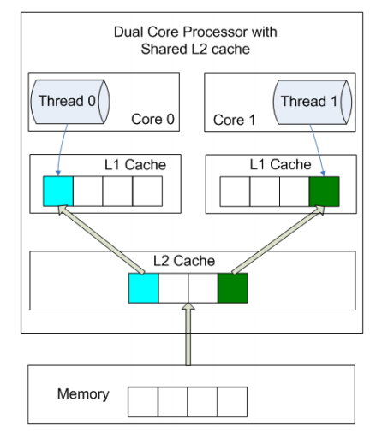
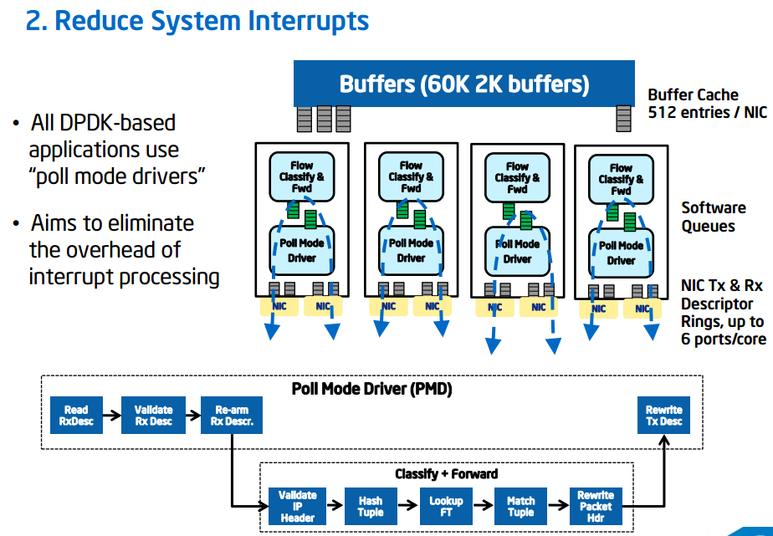
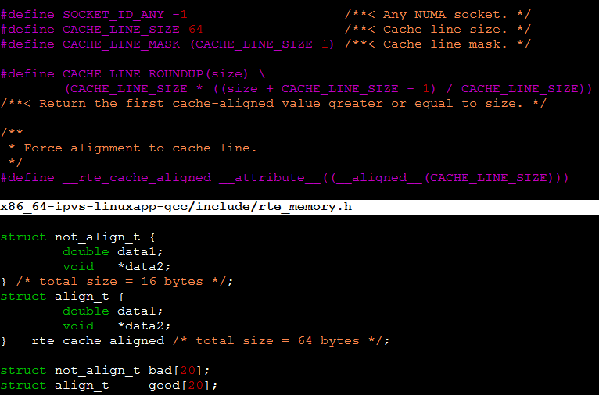
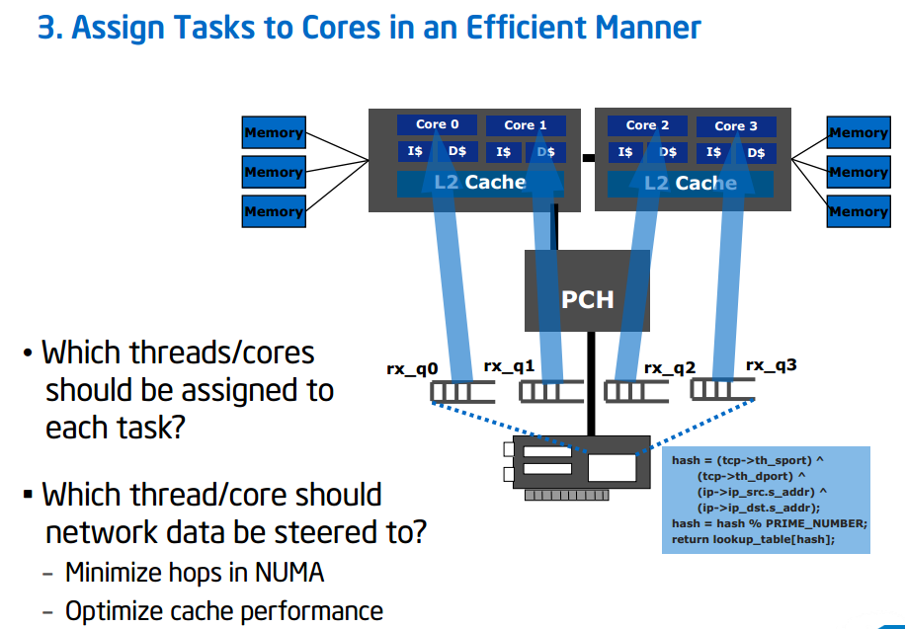
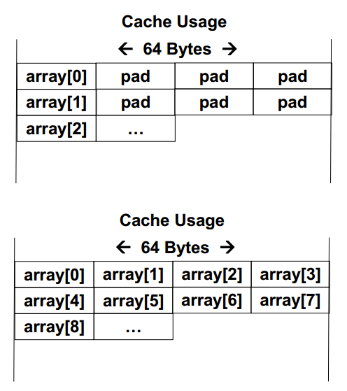
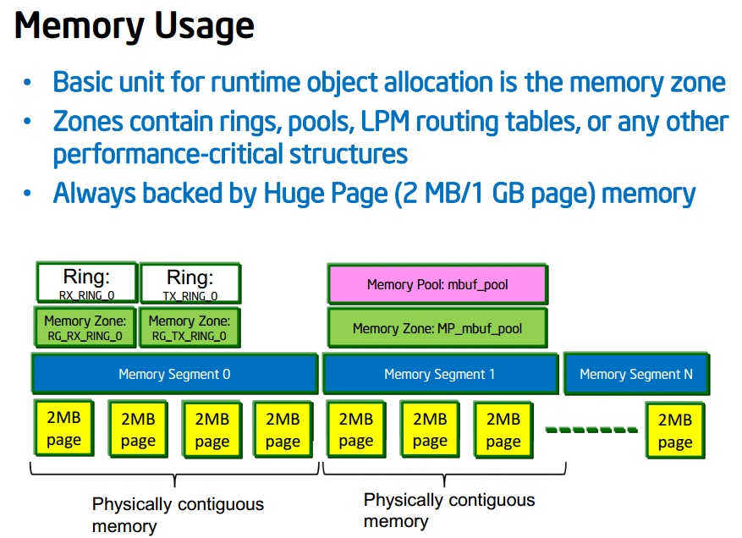
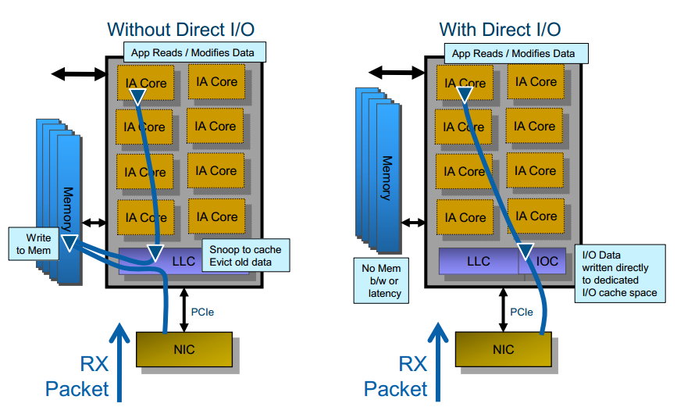
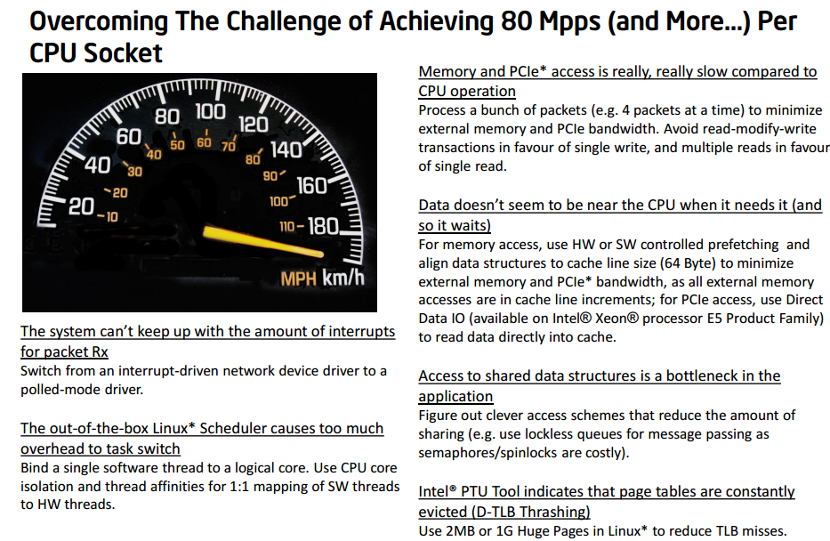
DPDK如何解决问题

Slide 29
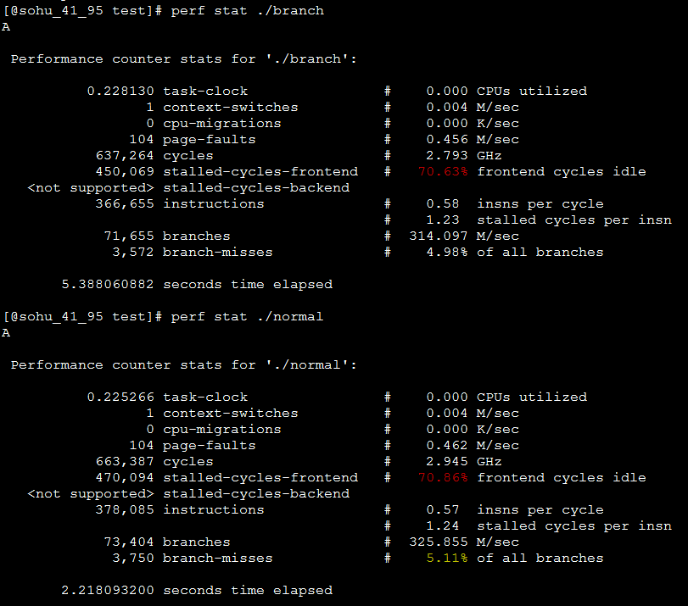
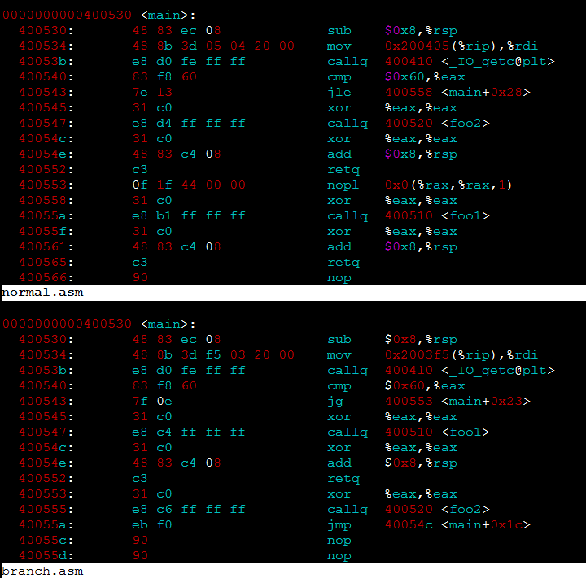
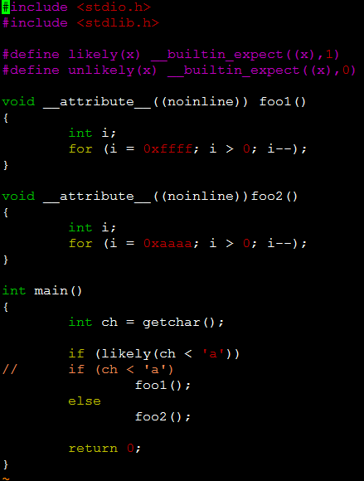
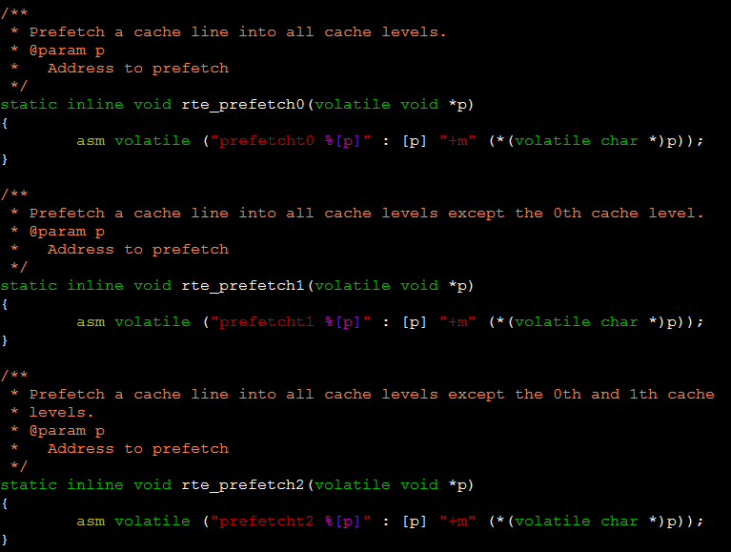
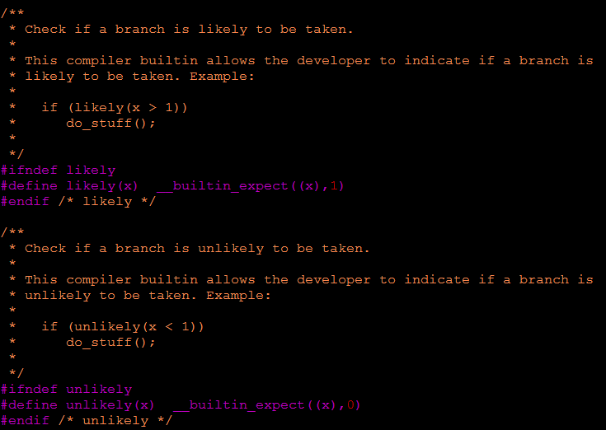
其他编程优化技术
Software prefetch
Branch Prediction
inline, complier option, ……
$ gcc -O3 test.c -o normal
$ gcc -O3 test.c -o branch
$ objdump -d branch > branch.asm
$ objdump -d normal > normal.asm

Slide 30
我们为什么要研究DPDK

Slide 31
Missouri：IP负载均衡解决方案
about
framework
performance test
roadmap

Slide 32
What is the Missouri
Alibaba LVS v3
DPDK mode
FULLNAT，TCP/UDP
percpu data

Slide 33
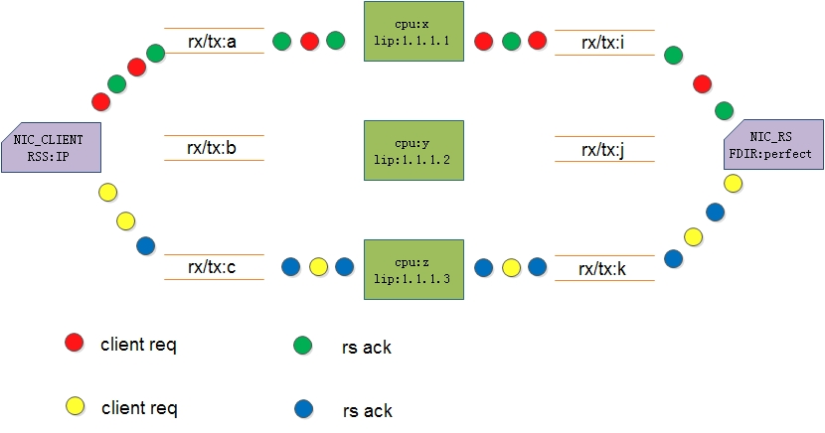
Missouri：network flow

Slide 34
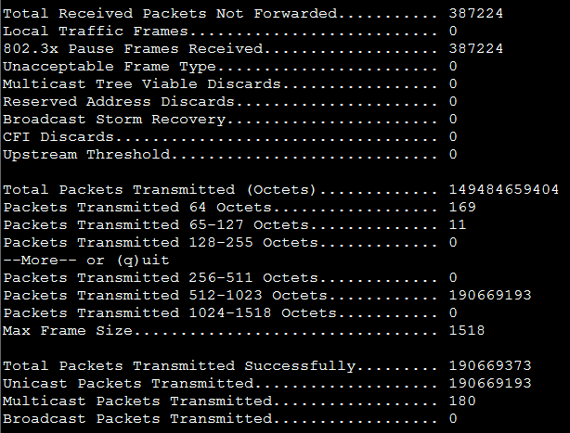
performance test
IEEE 802.3x
双工模式(Full Duplex)中提供流量控管的机制(Flow Control)；
如网络交换器产生拥塞时就会利用PAUSE frame 通知传送者暂缓送出封包，以减缓拥塞情况。

Slide 35
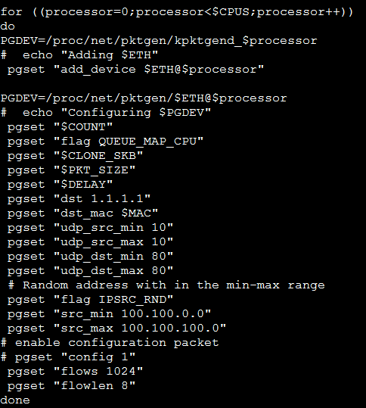
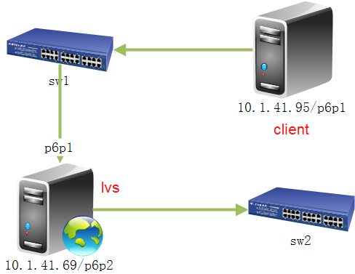
test environment
client:
Dell PowerEdge R720
Xeon CPU E5-2650 v2 @ 2.60GHz
82599ES 10-Gigabit SFI/SFP+
4 cpus
4 pktgen threads
25500 IP
server:
Dell PowerEdge R720xd
Xeon CPU E5-2620 @ 2.00GHz
10-Gigabit X540-AT2
Memory 16G

Slide 36
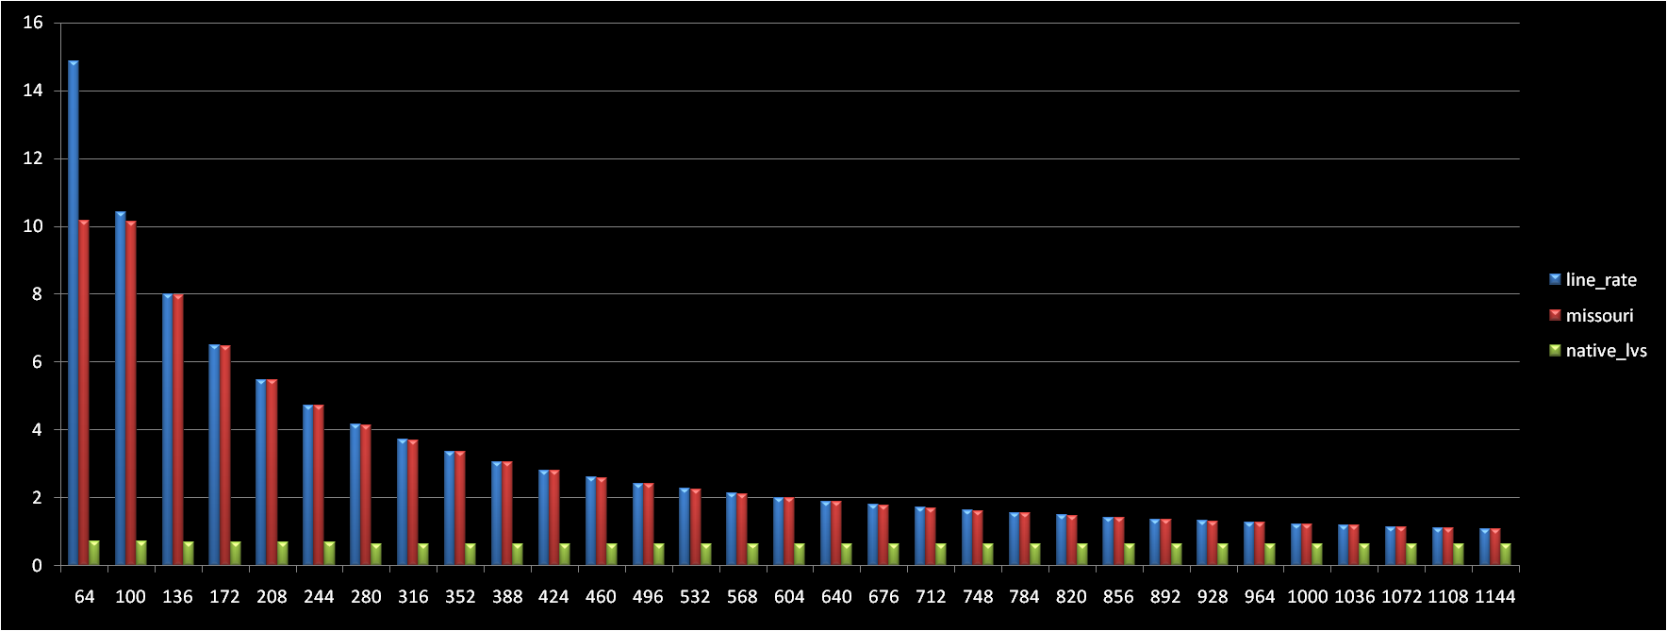
Missouri vs LVS

Slide 37
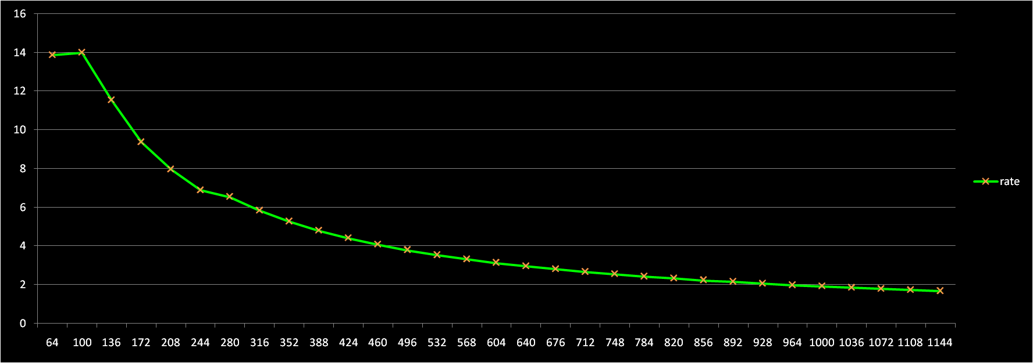
Missouri vs LVS

Slide 38
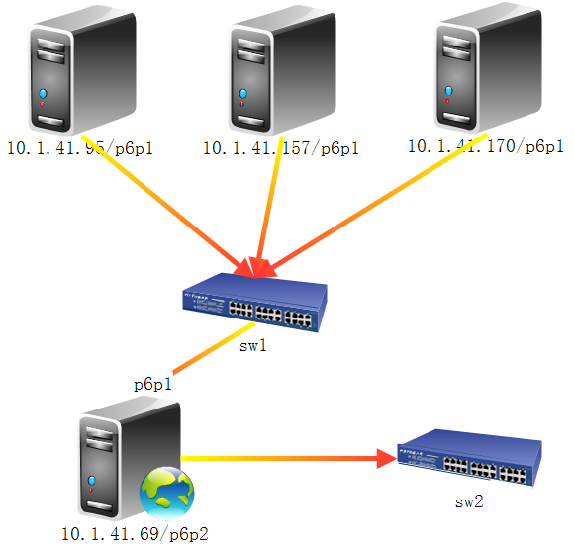
Missouri vs LVS
client:
Dell PowerEdge R720
Xeon CPU E5-2650 v2 @ 2.60GHz
82599ES 10-Gigabit SFI/SFP+
64字节
20 倍
server:
Dell PowerEdge R720xd
Xeon CPU E5-2620 @ 2.00GHz
10-Gigabit X540-AT2

Slide 39
Missouri：roadmap
ARP/RARP/ICMP/OSPF……
timer scheduler queue
(linux kernel task scheduler VS linux kernel timer list)
Ethernet POLL MODE DRIVER modify (RSS)
more scalable NUMA resource
static per-cpu data initialization
perf & optimization

Slide 40



谢谢

